Slide 1
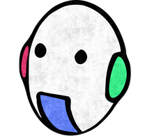



Seam Carving for Content-Aware Image Resizing
Presented by :
VAISHNAV Mohit and BATERIWALA Malav
Supervised by
DÉSIRÉ Sidibé and RASTGOO Mojdeh

Slide 2
Overview
Introduction
Methodology –energy map, vertical and horizontal seam removal, object removal, enlarging, amplification.
Results of all the applied algorithms
Conclusion and Contribution

Slide 3
Introduction
Objective of this project is to understand the paper by Shamir provided to us in the Image processing course, implement the project and if possible propose some changes.
Basic idea of this seam carving is to have the content aware image resizing technique.
Cropping is only limited to change or remove pixels from the periphery of the image. Better and effective resizing can only be achieved by considering the content of the image and not boundary limits.

Slide 4
Methodology
Energy Map , vertical and horizontal seam removal

Slide 5
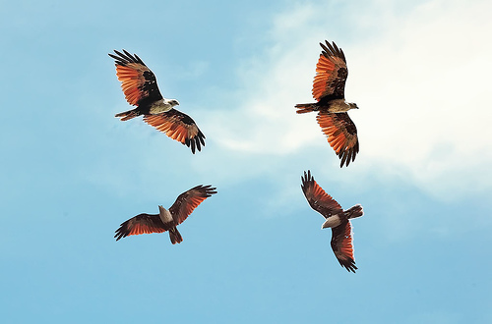
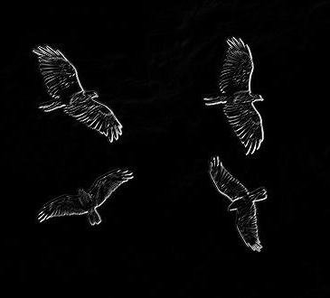
Energy maps

Slide 6
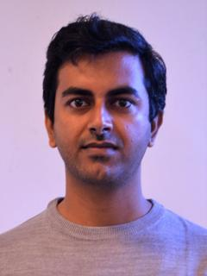
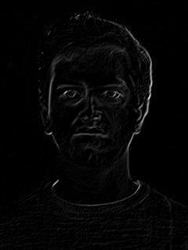
Energy maps

Slide 7
Methodology
Object removal

Slide 8
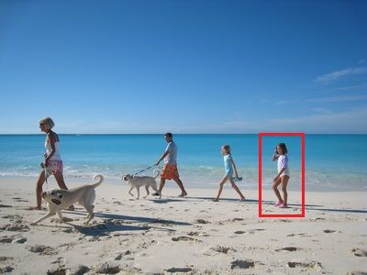
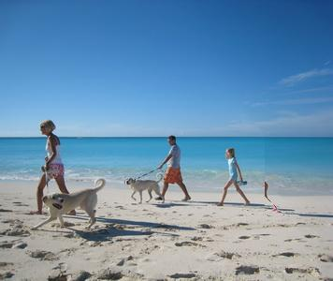
Object Removal example

Slide 9
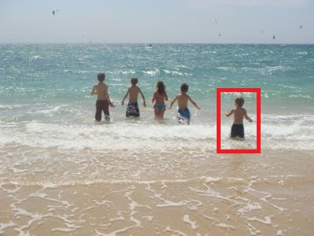

Object removal example

Slide 10
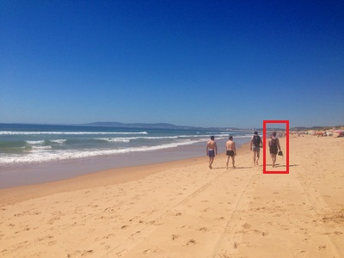
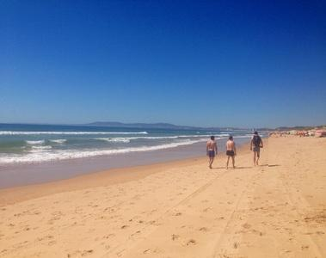
Object removal example

Slide 11
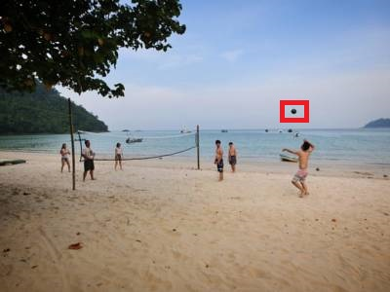

Object removal example

Slide 12
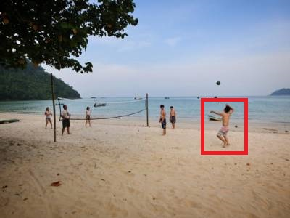

Object removal example

Slide 13
Methodology
amplification

Slide 14

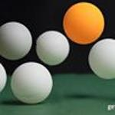
Amplification example

Slide 15
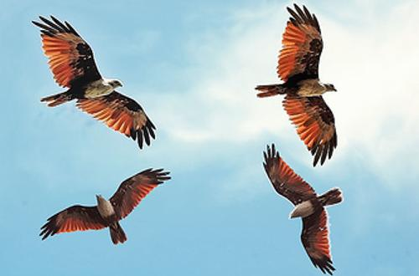
Amplification example

Slide 16
Methodology
enlarging

Slide 17
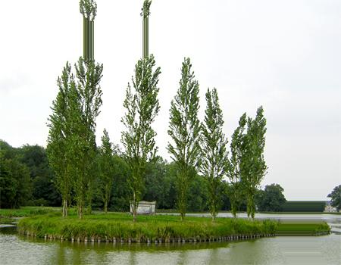
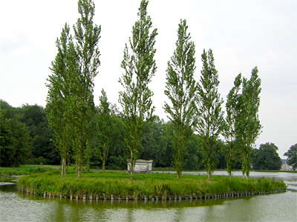
Enlarging example

Slide 18
Methodology
application

Slide 19
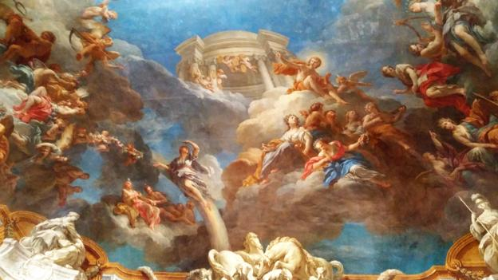
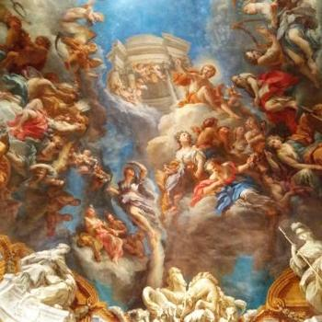
Application in arts
Roof top of Versailles castle

Slide 20
outputs

Slide 21
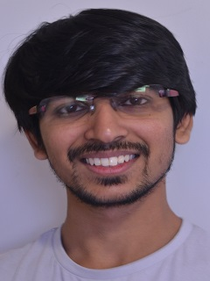
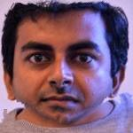
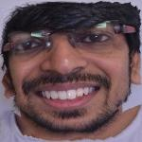
Failure of algorithm

Slide 22
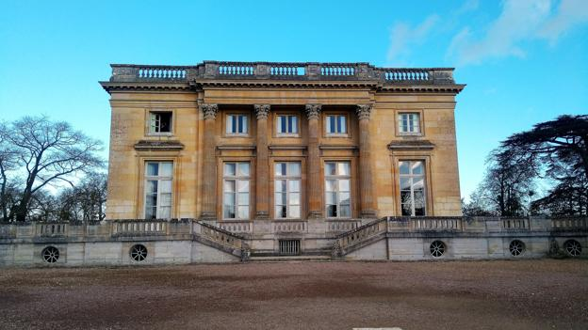
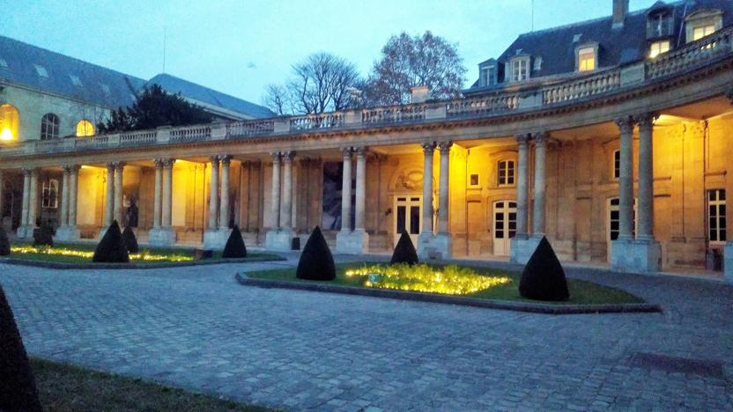
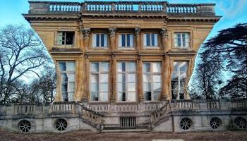
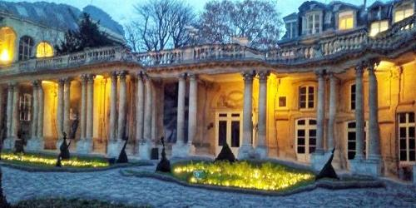
Failure of algorithm

Slide 23
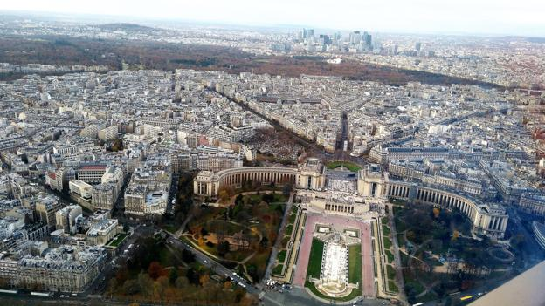
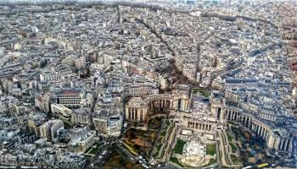
Failure of algorithm
View from top of Eiffel Tower

Slide 24
Contribution
Functional implementation of the paper.
1
Fast working by optimization.
2
Improved readability
3

Slide 25
References
AVIDAN, S., AND SHAMIR, A. 2007. Seam carving for content-aware image resizing. ACM Trans. Graph. 26, 3, 10.
CHEN, L., XIE, X., FAN, X., MA, W., ZHANG, H., AND ZHOU, H. 2003. A visual attention model for adapting images on small displays.
ACM Multimedia Systems Journal 9, 4, 353–364. CHO, T. S., BUTMAN, M., AVIDAN, S., AND FREEMAN, W. T. 2008.
EL-ALFY, H., JACOBS, D., AND DAVIS, L. 2007. Multi-scale video cropping. In MULTIMEDIA ’07: Proceedings of the 15th international conference on Multimedia, ACM, New York, NY, USA, 97– 106.
LI, J., AND LU, B.-L. 2009. An adaptive image euclidean distance. Pattern Recogn. 42, 3, 349–357. LIU, H., XIE, X., MA, W.-Y., AND ZHANG, H.-J. 2003. Automatic browsing of large pictures on mobile devices. In MULTIMEDIA ’03: Proceedings of the eleventh ACM international conference on Multimedia, ACM, New York, NY, USA, 148– 155.
MANJUNATH, B. S., OHM, J. R., VASUDEVAN, V. V., AND YAMADA, A. 2001. Color and texture descriptors. Circuits and Systems for Video Technology, IEEE Transactions on 11, 6, 703– 715.
PRITCH, Y., KAV-VENAKI, E., AND PELEG, S. 2009. Shift-map image editing. In ICCV 2009: Proceedings of the Twelfth IEEE International Conference on Computer Vision, 721.
http://kirilllykov.github.io/blog/2013/06/06/seam-carving-algorithm/
RUBINSTEIN, M., SHAMIR, A., AND AVIDAN, S. 2008. Improved seam carving for video retargeting. ACM Trans. Graph. 27, 3, 16. RUBINSTEIN, M., SHAMIR, A., AND AVIDAN, S. 2009. Multioperator media retargeting. ACM Trans. Graph. 28, 3, 23.

Slide 26


